Slide 1
American Express Default Prediction
Sprint 3
Group A1_04

Slide 2

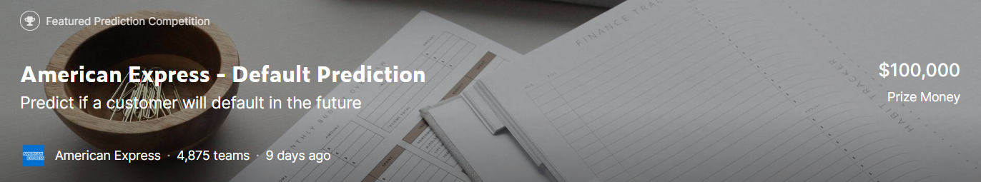

Background Review
The competition is sponsored by American Express, the world's largest payment card issuer with high industry recognition and is a classic risk control competition. In this competition, machine learning skills will be used to predict credit defaults. Specifically, industrial-scale data is used to build machine learning models. The training, validation and testing datasets include time series behavioral data and anonymous customer feature information.
https://www.kaggle.com/competitions/amex-default-prediction
Notes:
To sum up, our target is to predict the likelihood that a customer will not pay their credit card balance in the future based on their monthly customer profile.

Slide 3

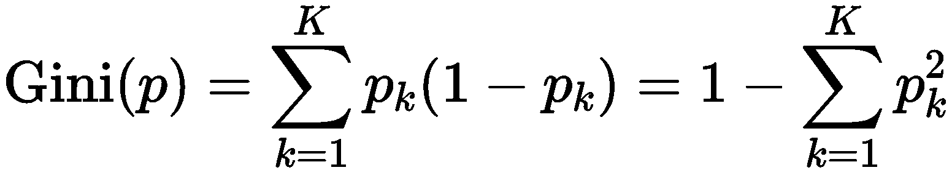
Dataset Review
Dataset features:
Anonymous profile information
Time-series behavioral features
Tag：Failure to pay within 120 days, tagged as 1
D_* = Delinquency variables
S_* = Spend variables
P_* = Payment variables
B_* = Balance variables
R_* = Risk variables
Metrics：
G：Normalized Gini Coefficient
D：Default rate captured at 4%
M = 0.5G + 0.5D
Dataset compression:
https://www.kaggle.com/datasets/raddar/amex-data-integer-dtypes-parquet-format
Notes:
So how do we tell if a customer is default
Failure to pay within 120 days, it is considered as a default
The weight of G and D:
0.5 and 0.5, is given by Kaggle. More seemingly determined by experience
The Gini index is like 熵, but the calculation is different. The equation of the gini index is
When the probability p is 1 or 0, there are no uncertainty . When p=1,g = 0, when p=0, g=0
In Sprint 1 a classmates asked questions about the metrics so here is a detailed illustration
G：Normalized Gini Coefficient
D：Default rate captured at 4%
In summary, the competitive indicator M measures the average of the normalized Gini coefficient G and the default rate D that captures 4%. Intuitively, let us optimize both the area under the dark red curve (the larger the better) and the intersection of the dark red curve with the green line (the higher the better). The evaluation function consists of two parts, the first part with a default weight of 0.5, which focuses on the ability to identify positive and negative samples, and the second part with a weight of 0.5, which focuses on the ability to capture the rate of

Slide 4
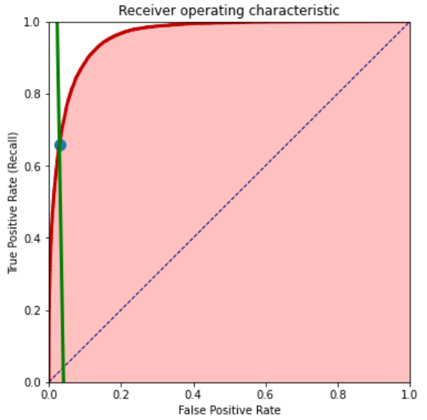
Metric
Normalized Gini Coefficient (G): G= 2 * AUC-1，-1<G<1, The larger the light red area, the better the score is.
Default rate captured at 4 % (D)：The true positive rate (recall) for a threshold set at 4 % of the total (weighted) sample count. It corresponds to the y coordinate of the intersection between the green line and the red roc curve (marked with a green dot) and is always between 0 and 1. The higher the intersection point, the better is the score.
The competition metric is the average of these two components. In other words: They want us to simultaneously optimize for a large red area under the curve and a high intersection point with the green line.
https://www.kaggle.com/code/ambrosm/amex-keras-quickstart-1-training
https://www.kaggle.com/code/inversion/amex-competition-metric-python
Notes:
Assuming you know the ROC (receiver operating characteristic) curve, the competition metric has a simple graphical explanation. The following diagram shows the ROC curve for the last fold in dark red. The area under the curve (AUC) is filled with light red. The green line corresponds to 4 % of all samples.
The competition metric has two components: the normalized Gini coefficient and the default rate captured at 4 %:
The default rate captured at 4 % is the true positive rate (recall) for a threshold set at 4 % of the total (weighted) sample count. It corresponds to the y coordinate of the intersection between the green line and the red roc curve (marked with a green dot) and is always between 0 and 1. The higher the intersection point, the better is the score.
The competition metric is the average of these two components. In other words: They want us to simultaneously optimize for a large red area under the curve and a high intersection point with the green line.

Slide 5
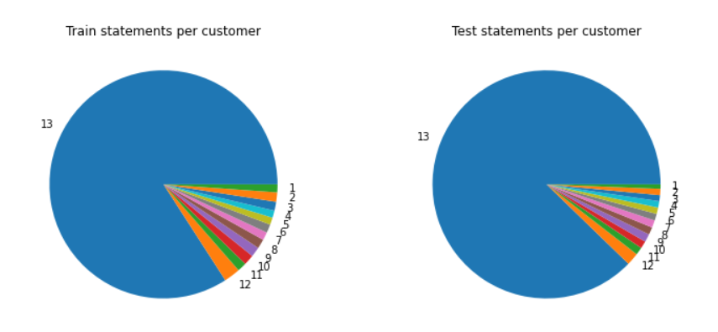
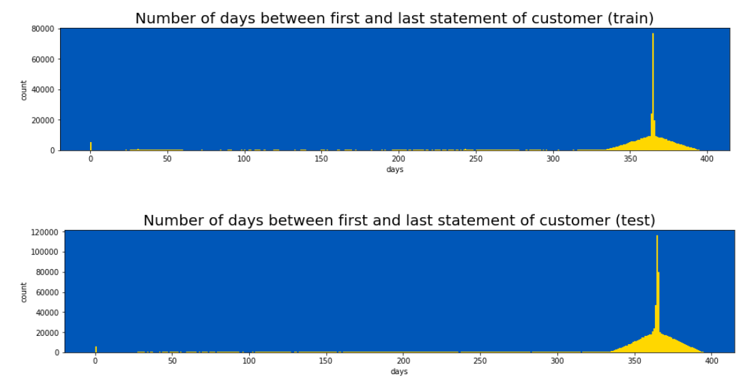
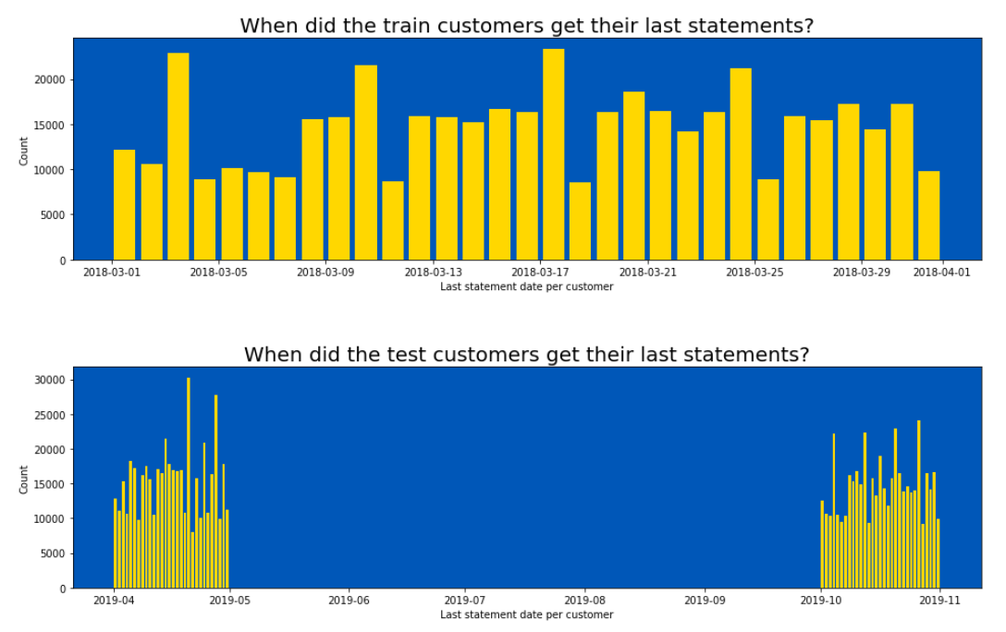
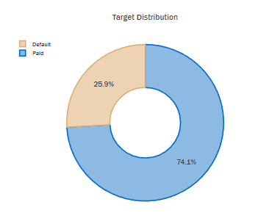
EDA
80% customers have 13 behavior records
20% customers have 1-12 behavior records
26% are default
The last statements of train customers are in 2018.3
The last statements of some test customers are in 2019.4 (public LB)
The last statements of the other test customers are in 2019.10(private LB)

Slide 6
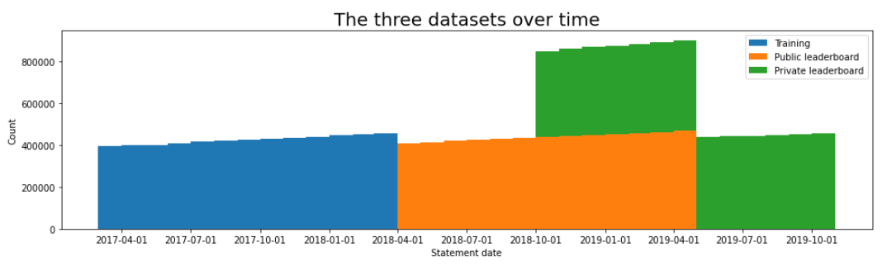
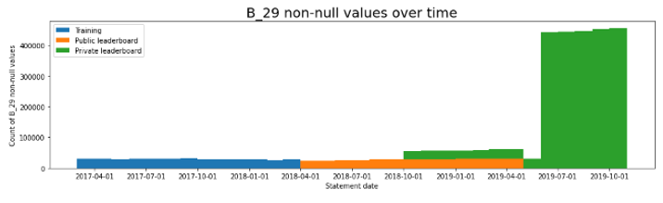
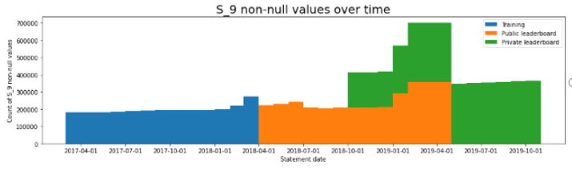
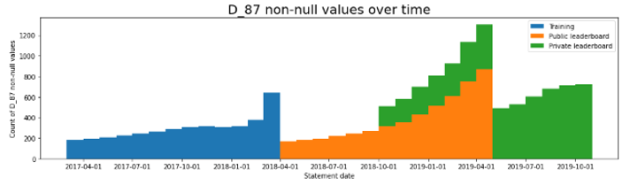
EDA
private LB from 2018.10 to 2019.04
Large number of features from 2019.07 to 2019.10 B29
https://www.kaggle.com/code/ambrosm/amex-eda-which-makes-sense

Slide 7
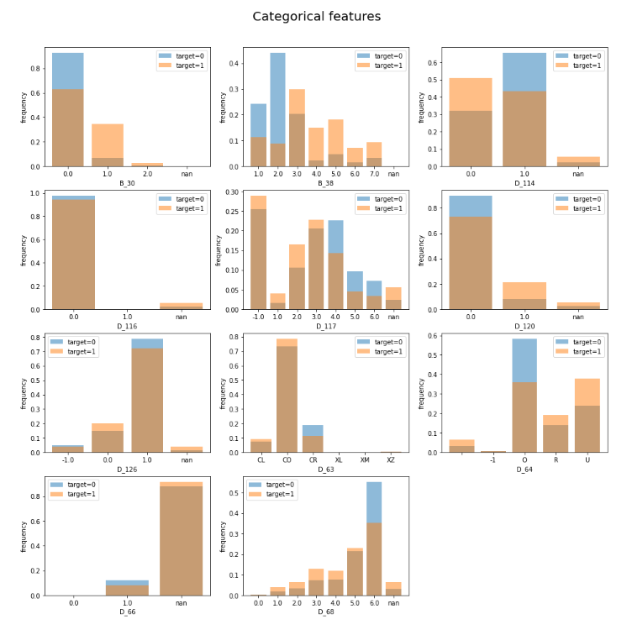
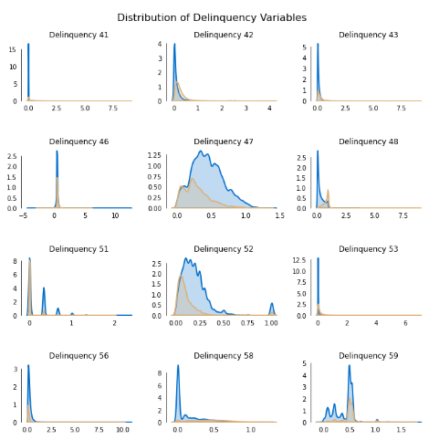
EDA

Slide 8

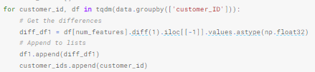

Feature Engineering
Aggregated features based on behavior
Fluctuation features
Extended meaning-based
features
Notes:
Features:
Statistical features: mean, standard deviation, minimum, maximum
First and Last:
For example,
Some features are from the community, hard to explain why
Use it because the result will be better.

Slide 9
Feature Engineering
- Delete D_103、D_139（https://www.kaggle.com/code/raddar/redundant-features-amex/notebook）
Calculate sum for spend_p+payment_p+delq+balance_p…
…
…

Slide 10

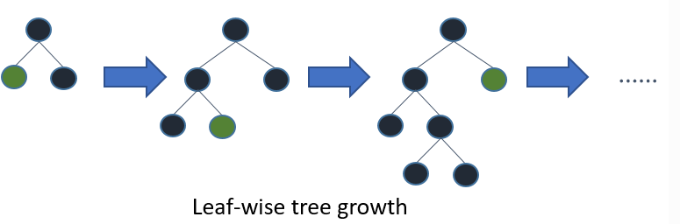
Light GBM
Gradient Boosting Framework that uses tree based learning algorithms (Microsoft, 2016)
Advantages:
Faster training speed and higher frequency
Lower memory usage
Better accuracy
Support of parallel, distributed, and GPU learning
Capable of handling large-scale data
https://www.kaggle.com/code/ambrosm/amex-lightgbm-quickstart
Notes:
Gradient boosting is a type of machine learning boosting. It relies on the intuition that the best possible next model, when combined with previous models, minimizes the overall prediction error. The key idea is to set the target outcomes for this next model in order to minimize the error.
(https://www.displayr.com/gradient-boosting-the-coolest-kid-on-the-machine-learning-block/)
(https://becominghuman.ai/lightgbm-on-home-credit-default-risk-prediction-5b17e68a6e9)

Slide 11
Next Sprint Goals
- Continue to refine the model, adjust the parameters…
Integrate LGBM and XGB
Notes:
GPU

Slide 12
Q&A
Thank you!

